Slide 1
Validation Hub Project
31st October 2018

Slide 2
Who is AIMS?
Application and Implementation of Methodologies in Statistics (AIMS) Special Interest Group
Tasked by the PSI Board of Directors to investigate the use of R software in the industry and the validation of R
Formed in May 2016
Representatives from Bordeaux University Hospital Clinical Epidemiology Unit, GSK PPD, PRA, Roche, Servier, Syne Qua Non,
Initiated an R Consortium project to build a Validation Hub
In 2018, we realized that this is bigger than AIMS and decided to set up a worldwide team to jointly collaborate on the project
We need YOU !!

Slide 3
Our Partners
R Consortium
Joseph Rickert / John Mertic
ASA Biopharmaceutical Section Working Group on Software
Alex Dmitrienko / Greg Cicconetti / Keaven Anderson + Others
TransCelerate
Min Lee / Andy Nicholls
FDA (Paul Schuette / Tomas Drgon / Mat Soukup)
EMEA / PMDA - Contacts required!
Company Volunteers
Including Abbvie, Amgen, Biogen, Eli Lilly, GSK, J&J, Novartis, Merck, Pfizer, PPD, PRA, Roche, Syne qua non.

Slide 4
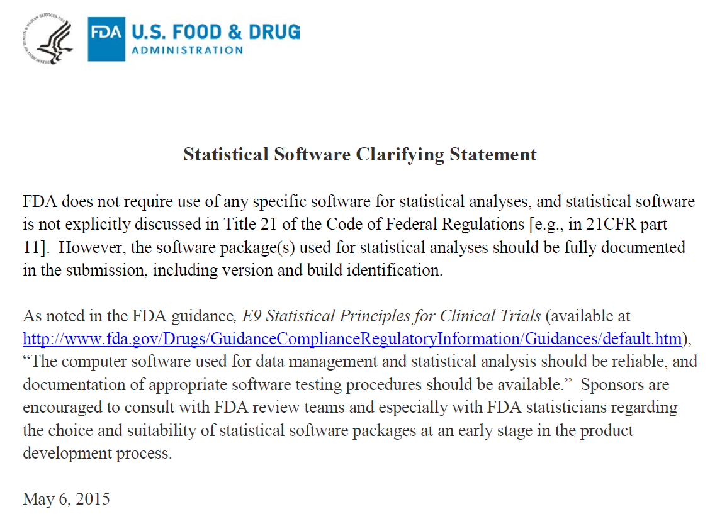
Setting the Scene
https://www.fda.gov/downloads/ForIndustry/DataStandards/StudyDataStandards/UCM587506.pdf

Slide 5
Setting the Scene
We don’t have to use SAS for statistical analysis
Use of R remains limited
Why?
SAS is the best thing ever invented?
R is rubbish?
Lack of knowledge/training?
Lack of understanding of regulatory requirements?
One Goal of the PSI AIMS SIG is to improve knowledge and understanding in these areas

Slide 6
The R Foundation’s Documentation
Key Points
“The members of R Core constitute a widely recognized, international team of experts on statistical computing and software development.”
Source Code Management (SVN) used such that development is traceable
And publicly available
Accompanied by ‘NEWS’ file
Mailing lists and bug tracking system facilitate user feedback
“A set of validation tests are maintained and upgraded by R Core to enable the testing of source code against known data and known results”
Regular release cycles
Availability of patched releases

Slide 7
Summary
Provided this matches up with our own internal Quality Assurance SOPs, Base R is fine to use for regulatory work once we’ve qualified the environment internally (essentially, verifying that our installation has been successful)
But what about R Packages?
May come from anywhere
Be written by anyone
Or May not follow a typical Software Development Lifecycle

Slide 8
Challenges of Using R Packages
PSI AIMS SIG have initiated an R Consortium endorsed project to create an online “validation” hub for R
The platform will
Standardise the packages we use
Provide links to useful QA information
Be a platform for sharing tests
Enable statistical discussion
Lead to a more consistent approach to R validation (and open source in general)
Be free to use
More detail: https://www.r-consortium.org/announcement/2018/05/29/announcing-the-r-consortium-isc-funded-project-grant-recipients-for-spring-2018

Slide 9
Starting point for Validation Framework
Determine requirements/specifications for the package - you can’t validate something without documenting what it is that you’re trying to use it for
Assess the risks – Mixture of quantifiable things (package lifetime, number of downloads, number of tests within package, does it have a news feed?) and non-quantifiable (reputation of author, quality of news feed)
Test requirements (i.e. produce evidence of mitigating risks) Note: For Statistical packages – all need to test methods
https://github.com/pharmaR
Discussion on Slack: RValidationHub

Slide 10
Teamwork – Divides the task and multiplies the success !!!
R software is free and we want to keep it that way. Together we can make it more accessible for use in the pharmaceutical industry.

